Slide 1
CSE496 System Estimating Tomato Size on Branches in Greenhouses
CSE 496
Final Presentation
Emre YILMAZ
Project Supervisor: Prof. Dr. Yusuf Sinan Akgül
June 2024

Slide 2
Content
Project Scheme and Description
Segmentation and Data Preparing
Size Estimation
Success Criteria
Resources

Slide 3
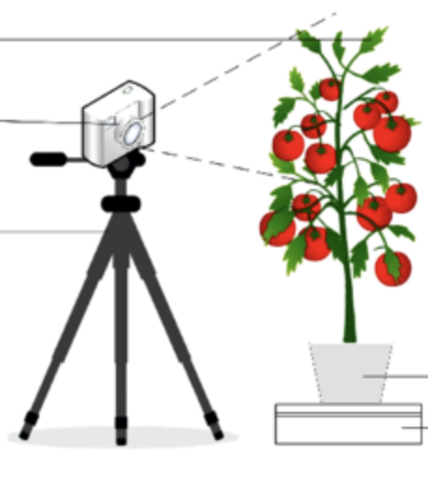
Project Scheme and Description
Monitoring the number of flowers on a plant provides valuable insights into its reproductive health and potential yield
Quantifying tomato yield allows farmers to assess the effectiveness of their cultivation practices and make informed decisions.
Monitoring changes in tomato size provides real-time feedback on plant growth and fruit development dynamics.
Model
*[1]
«3 tomatoes»
«3 flowers»
«12% size increase»

Slide 4
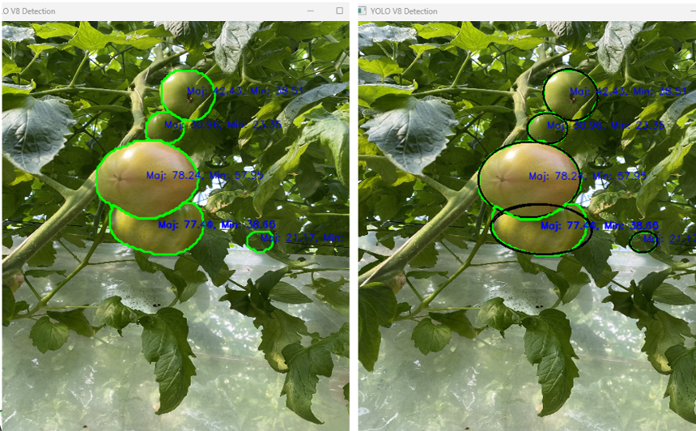
Segmentation

Slide 5
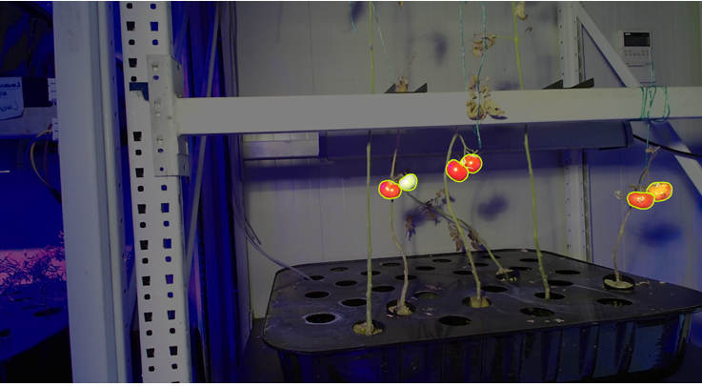
Segmentation and Data Preparing
Greenhouse dataset is collected and segmented for size estimation model.
However…

Slide 6
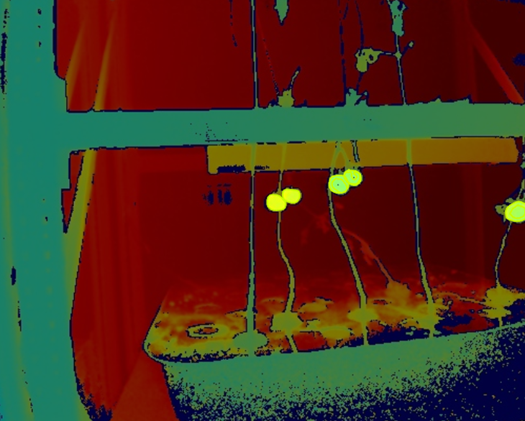
Segmentation and Data Preparing
While collecting data, the depth image and RGB image were not aligned.
Depth images were also segmented separately, alongside the RGB images.
Approximately 300 tomatoes were segmented both as RGB and depth images.

Slide 7
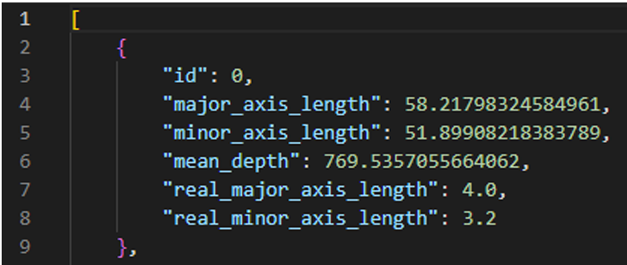
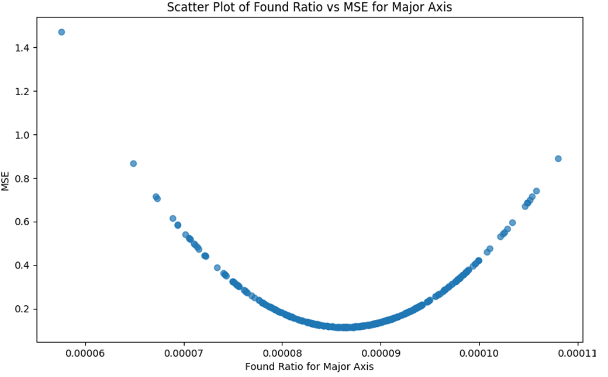
Size Estimation
A JSON file is generated for size estimation model.
For each entry, the method calculates a ratio of the real length to the product of the pixel-based length and the mean depth.

Slide 8
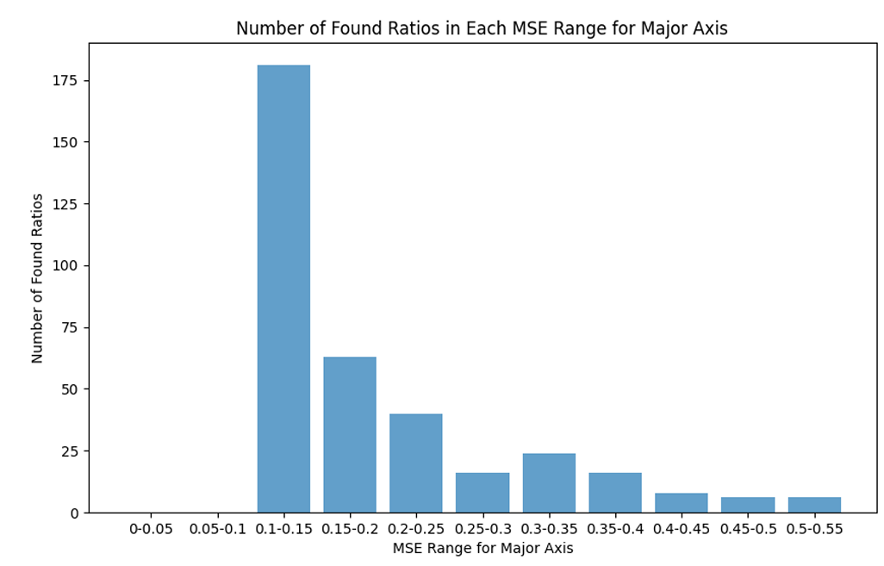
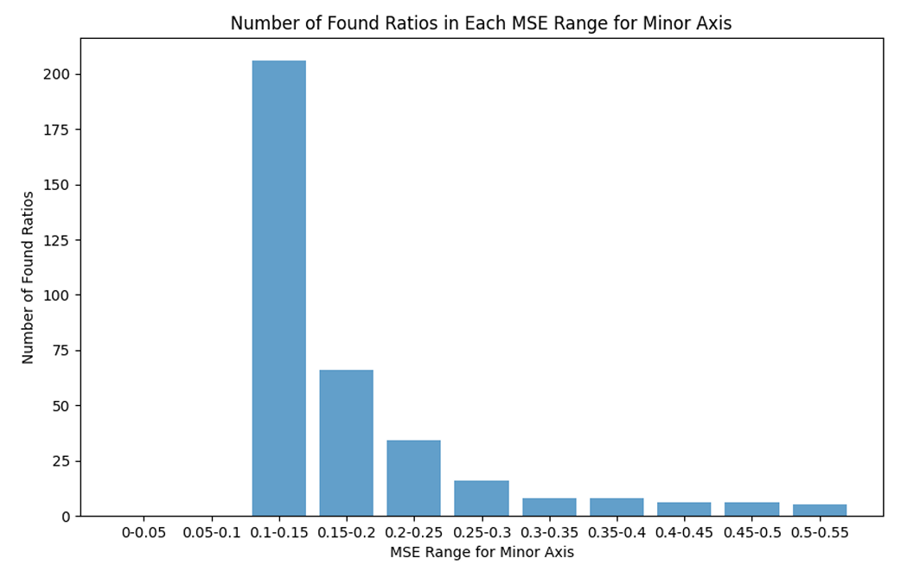
Size Estimation
A JSON file is generated for size estimation model.
For each entry, the method calculates a ratio of the real length to the product of the pixel-based length and the mean depth.

Slide 9
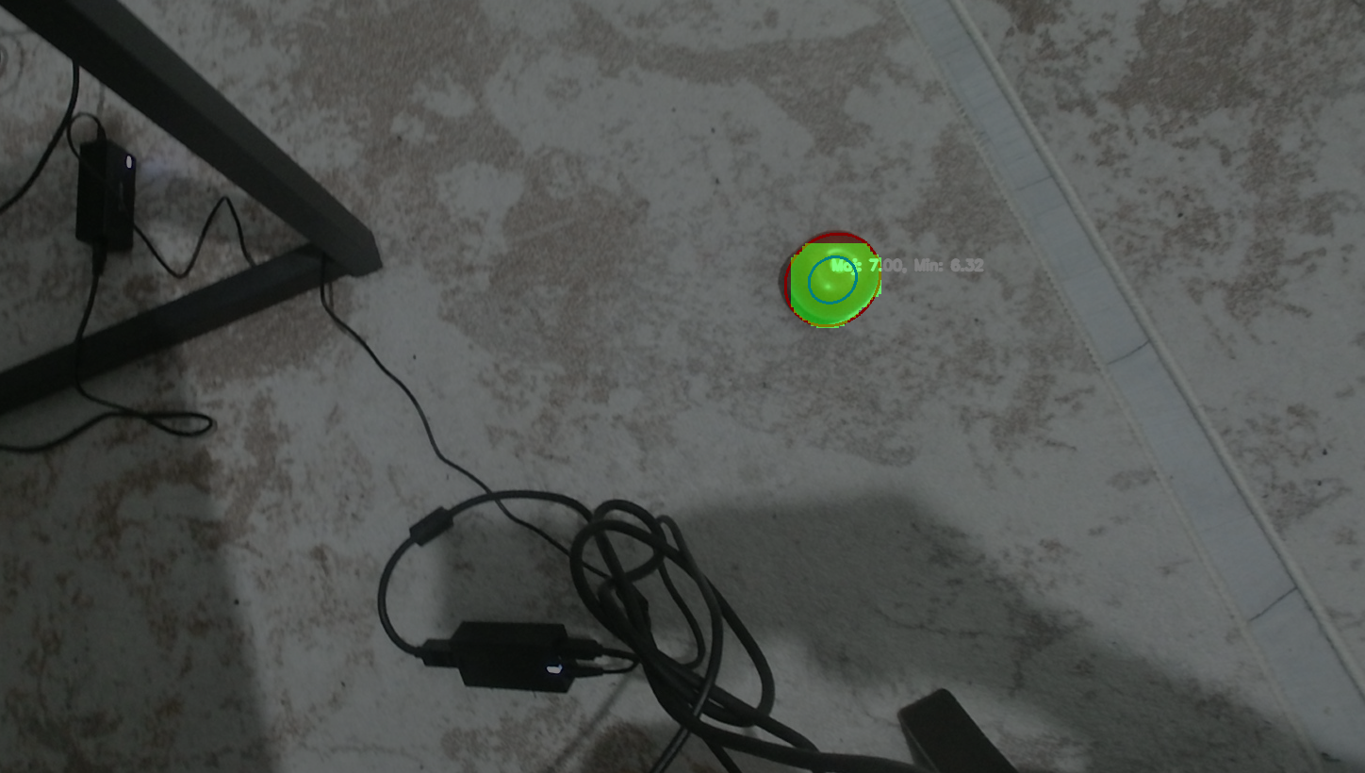
Size Estimation

Slide 10
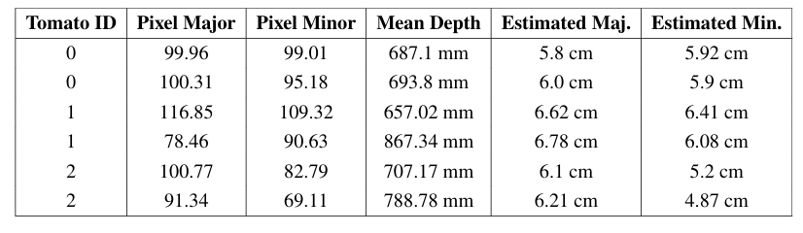

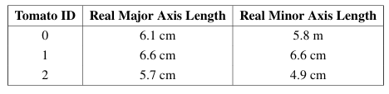
Size Estimation
A demo was conducted with the found parameters, and the result was observed to be successful.

Slide 11
Evaluation of Success Criteria
Criteria – 1: 85% F1 score for tomato detection
Segmentation model has %80.5 F1 score
Criteria – 2: 10% MSE for size estimation
This criterion was successfully met. Both the training and demo phases demonstrated that the MSE for size estimation remained well below the 10% threshold,
Criteria – 3: 85% F1 score for flower detection
Failure.

Slide 12
References
[1]: Study on the detection of water status of tomato (Solanum lycopersicum L.) by multimodal deep learning)

